Slide 1
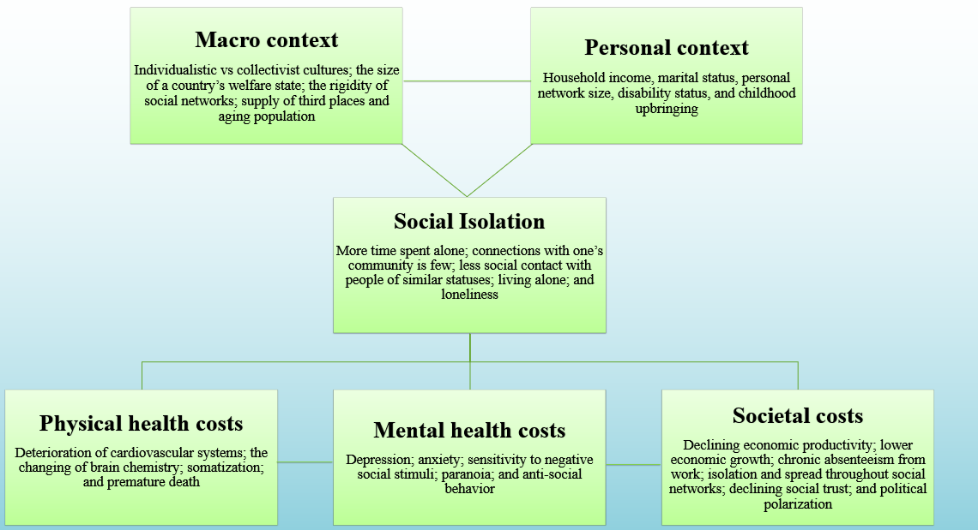



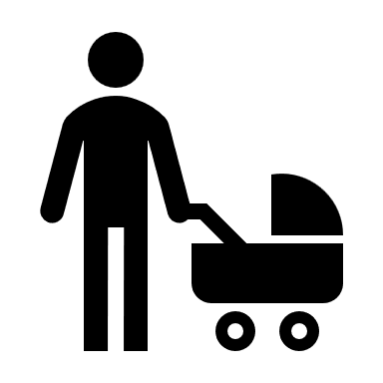

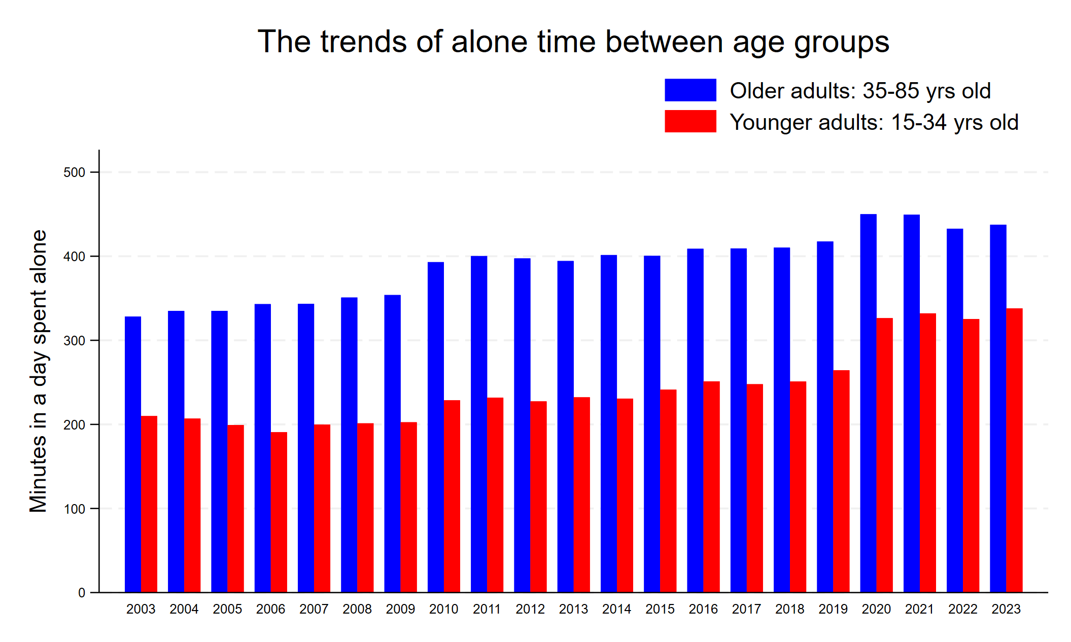
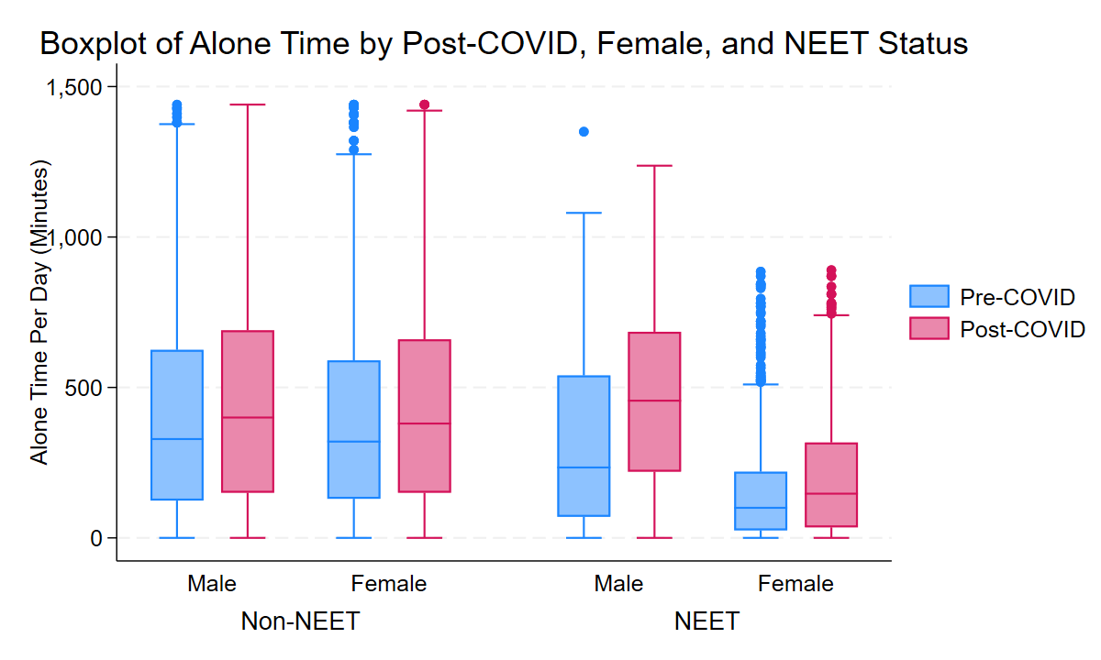




American hikikomori: The socially isolated world of economically detached young men
Nicholas Hess | Master’s of Public Policy | Michigan State University
Are disconnected young adults lonelier than their peers?
The interconnected world of disconnection
Initially, NEETs were not spending more time alone than non-NEETs, but when controlling for gender and parental status, the differences were clear
Social isolation – A lack of relationships and social networks. Can be measured objectively using metrics such as living alone or number of friends.
Loneliness – A subjective feeling of disconnectedness; a mismatch of one’s desired levels of social connection and their actual level connection.
Isolated
NEETS- those not in employment, education or training.
Definitions
NEETs
25 minutes
Legal guardians
Women
54 minutes
42 minutes
Methodology
Results
This research analyzes trends in the American Time Use Survey from the Bureau of Labor Statistics starting in 2003 and ending in 2023.
The survey contains a detailed diary of activities broken down by the minute for each respondent, most importantly including who the respondent spent the activity with. I looked at respondents who spent activities alone, excluding personal activities, as well as work activities. The survey also contains social and economic characteristics
I was particularly interested in those who classify as NEETs and whether they spent more time alone
For male NEETs (15-34), the pandemic was particularly challenging for socialization, suggesting that intersectional socioeconomic statuses amplify or diminish one’s isolation.
Although older individuals tend to spend more time alone, much of the increase have been young adults
Both short-and-long-term fixes are needed to adequately address the loneliness epidemic.
How NEETs divided by gender fared post-pandemic
139 minutes
49 minutes
Even before the pandemic, male NEETs spent on average an hour more alone than female NEETS. Post-pandemic this gap grew to nearly 100 minutes.
Policy recommendations
Social connectedness is the antidote to our epidemic of isolation. Social isolation was created by the political and economic choices we have made; to make lasting change, the way we frame isolation needs to also change.
66 minutes
COVID pandemic
147 minutes
1). The US should expand national service, programs like AmeriCorps and YouthBuild, to reach low-income younger adults.. Congress should pass the Cultivating Opportunity and Response to the Pandemic through Service (CORPS) Act. Programs will instill civic virtue and connect people together.
2.) States should implement pilot programs to establish local officers to tackle isolation. The solution lies in a person’s connection with their community. These offices will promote community, raise awareness, and coordinate with other local departments. Stopping isolation in public school is key.
Younger adults’ alone time have increased relative to older adults, post-pandemic
Although both white and BIPOC NEET respondents increased their alone time post-pandemic by about the same amount, BIPOC individuals spend more time alone than white respondents
68 minutes
BIPOC
(Black, indigenous, people of color)
308 minutes
3.) Social prescribing should be covered by insurance. Social prescribing is when non-medicinal solutions are prescribed to individuals who experience mental pathologies, not limited to loneliness. Our epidemic of isolation is, first and foremost, a health epidemic. Congress should pass legislation to stipulate that insurers cover social prescribing.
Even Male Non-NEETs after the pandemic are more likely to spend time alone than female NEETs. Female non-NEETs, both pre-and-post-pandemic were not statistically different.
110 minutes
White
262 minutes
22 minutes
16 minutes

Slide 2
Macro context
Individualistic vs collectivist cultures; the size of a country’s welfare state; the rigidity of social networks; supply of third places and aging population
Personal context
Household income, marital status, personal network size, disability status, and childhood upbringing
Social Isolation
More time spent alone; connections with one’s community is few; less social contact with people of similar statuses; living alone; and loneliness
Physical health costs
Deterioration of cardiovascular systems; the changing of brain chemistry; somatization; and premature death
Mental health costs
Depression; anxiety; sensitivity to negative social stimuli; paranoia; and anti-social behavior
Societal costs
Declining economic productivity; lower economic growth; chronic absenteeism from work; isolation and spread throughout social networks; declining social trust; and political polarization

